Slide 1
Football Players Stats (Premier League 2021-2022)
- By Mahesh Kumar P.

Slide 2
This dataset contains Statistics of football players from Premier League (2021-2022)
Y = The Goals variable. (0/1) with prob = 0.5.
There are around 33 X variables which gives us Y.

Slide 3
The 29 Column names listed below are the key variables (X's) to conclude the Y variable and are Abbreviated as follows:
Player: Player's name. Team: Played club during 2021-2020. Nation: Player's nation. Pos: Position that one plays in. Age: Player's age. MP: Matches played. Starts: Matches started in the playing 11. Min: Minutes played. 90s: Minutes played divided by 90. Gls : Goals scored or allowed. Ast: Assists. G-PK: Non-Penalty Goals. PK: Penalty Kicks made. PKatt: Penalty Kicks attended. CrdY: Yellow Cards. CrdR: Red Cards. Gls 90: Goals scored per 90 mins. Ast 90: Assists per 90 mins. G+A 90: Goals and Assists per 90 mins. G-PK 90: Goals minus Penalty Kicks made per 90 mins. G+A-PK 90: Goals plus Assists minus Penalty Kicks made per 90 mins. xG: Expected Goals. npxG: Non-Penalty Expected Goals. xA: Expected Assists. npxG+xA: Non-Penalty Expected Goals plus Expected Assists. xG 90: Expected Goals per 90 mins. npxG 90: Non-Penalty Expected Goals made per 90 mins. xA 90: Expected Assists made per 90 mins. npxG+xA 90: Non-Penalty Expected Goals plus Expected Assists made per 90 mins.

Slide 4
Overview:
Football Analytics has become more and more obvious these days and has originated since the 18th Century. The main concept of bringing this data is to check the output of Goals and determining the players who perform well, gaining that competitive edge over others that has continued since World War II. Football managers and Directors spend a lot of time and money before they bring a particular player in their squad and build a team who could lead them to the League Cups and Titles there are to win.
The Expected Goals ratio has been one of the most revolutionary metrics to calculate the output of Goals for a team and the probability of scoring them is based on several factors like distance, angle of the shot, weak foot or strong foot, type of attack, direction of shot taken etc. Again, Goals are not the only measure of a players worth since, the one who passes, and the way that pass had been made for the scoring player, who has created the chance for the Goal scorer, is of the highest recognition and prominence. Some players score less Goals but the way they give away the ball so that a Goal is scored is called an Assist and it has the same value as a Goal in Football.

Slide 5
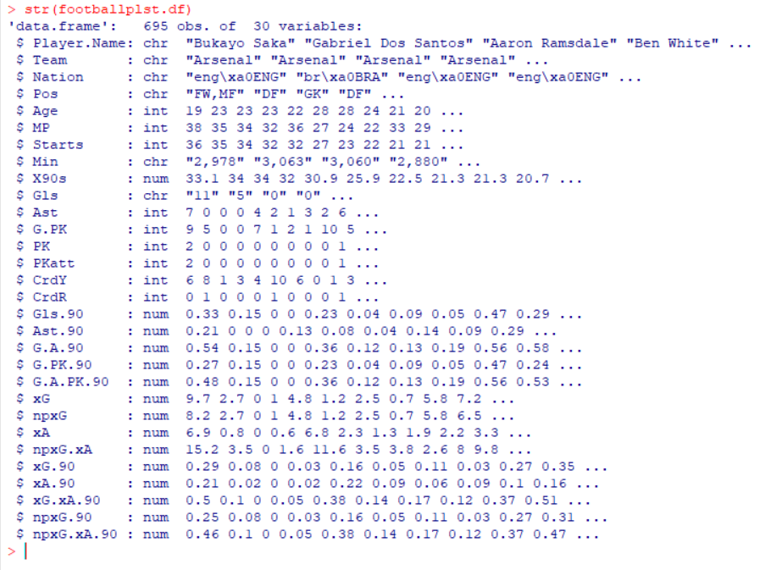
Overview: Structure and Summary of Data The Data frame has 695 Observations 30 Variables(columns). Now, removal of NULL values and empty rows of the extra players is done from the footballplst.df to minimize the difference in the summary statistics in the new data frame i.e., fbplst.df where we get only 546 observations when compared to the 695 in the previous one.

Slide 6
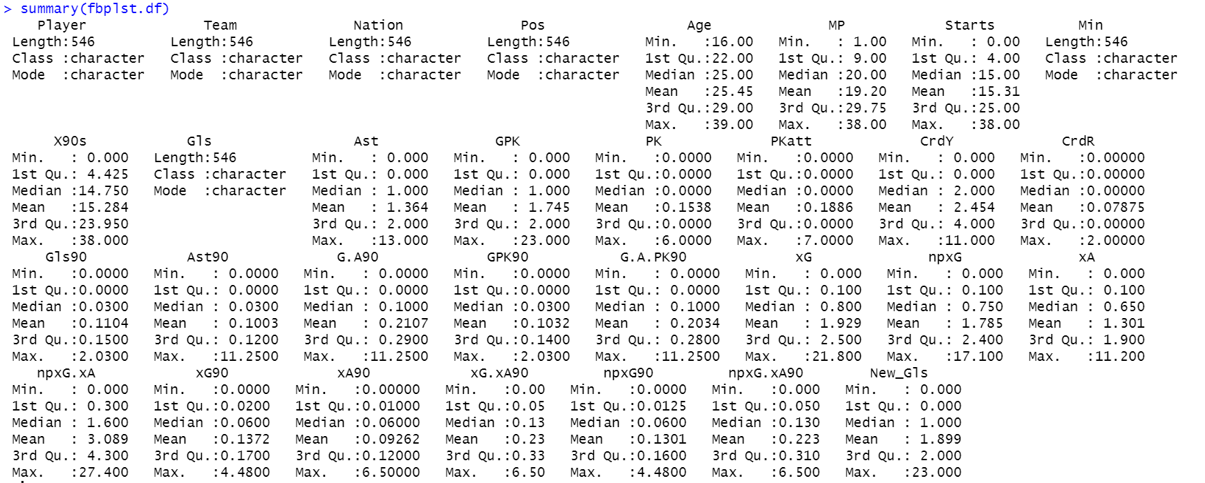
Overview: Structure and Summary of Data As seen in the figure, there is elimination of 149 variables using the command na.omit(footballplst.df). Now, summary statistics is generated and then we see the mean, variance, min-max values, and the quarters of each column with 546 observations in brief.

Slide 7
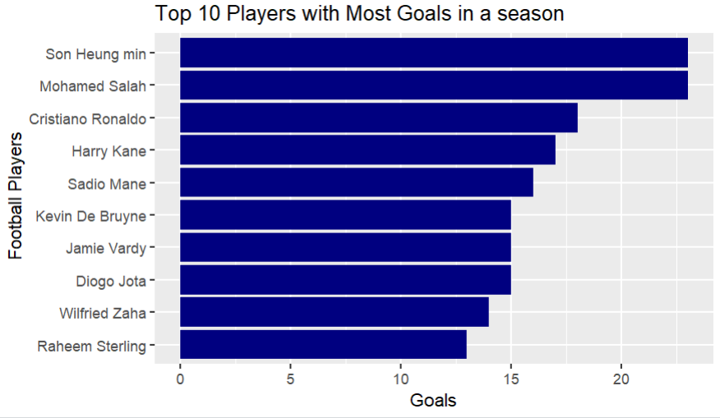
Overview: Top 10 Players with Most Goals As seen in the bar chart below, the Top players to score the most Goals in the season 2021-22 are ‘Son Heung min’ and ‘Mohamed Salah’ with 22 Goals each. ‘Cristiano Ronaldo’ has scored 18 Goals and is the second highest to make this feat while ‘Harry Kane’ is the third highest scorer with 16 Goals. The Golden boot Award for the most Goals in the Premier League will be shared by the Top 2 players and the rest are eligible for a consolation prize.

Slide 8
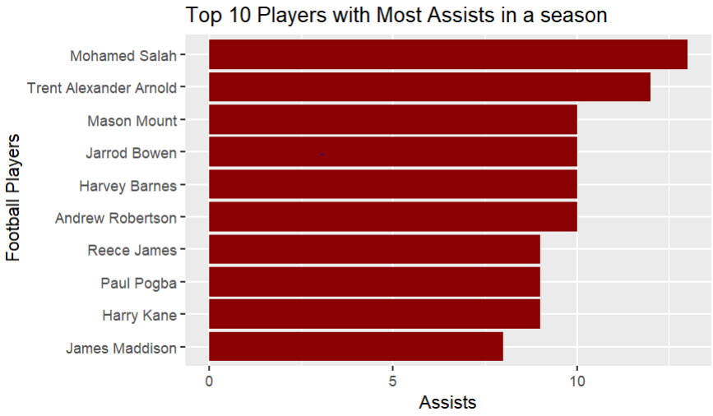
Overview: Top 10 Players with Most Assists Similarly, in the bar chart below, the players with the greatest number of Assists are plotted where ‘Mohamed Salah’ takes the crown again. The second place is occupied by ‘Trent Alexander Arnold’ who is the Defensive player and a teammate of the Assist crown Salah.

Slide 9
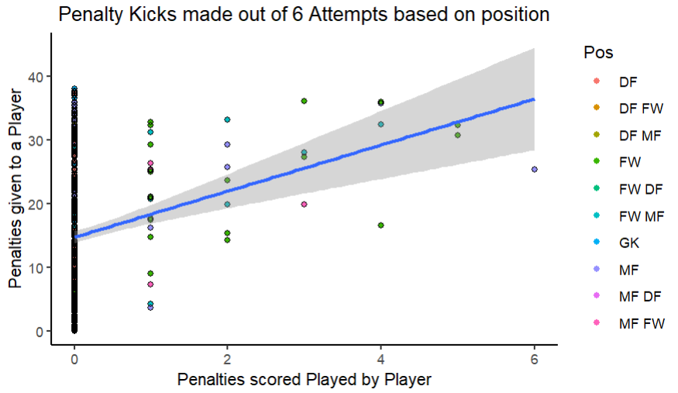
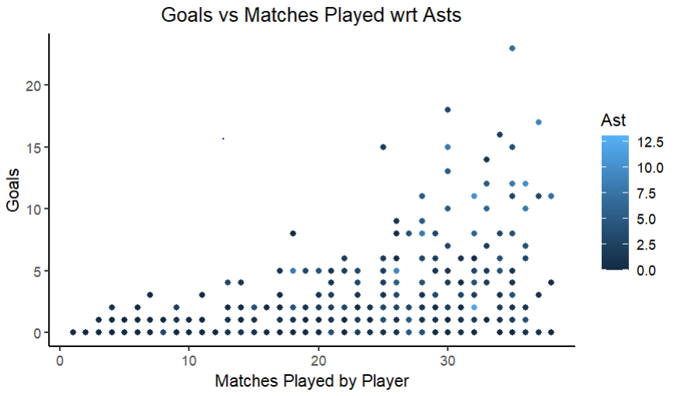
As seen in the diagram below, the player with most Assists has light colored dots and tend to be on the right side of the plot. The darkest blue plot indicates players with no assists and the deduction can be made that Players who have scored more Goals have played a minimum of 30 Matches in a single season. The Green dot in second plot shows a Mid Fielder scoring 6 penalty goals while the green color shows the Forwards who has scored 5 penalties each of them spending approximately 35 minutes for each goal. The blurry bar at 0 shows the players who have not scored or attempted the penalty out of the 540 remaining players.

Slide 10
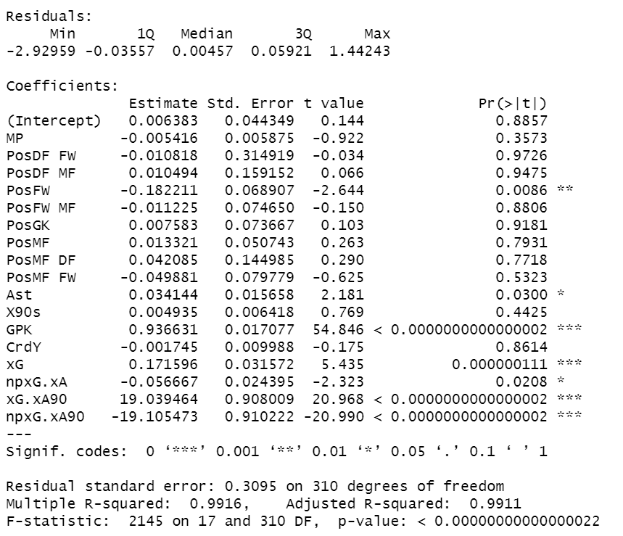
1.) Linear regression model is run on the data frame by selecting only the desired or most wanted variables that effect the Goal value of a Player and how it effects indirectly. Now, the regression model is run with 10 regressors optimizing our result to get the R-square, std - error, residuals, and the corresponding p-values to show the significance of the variables.

Slide 11
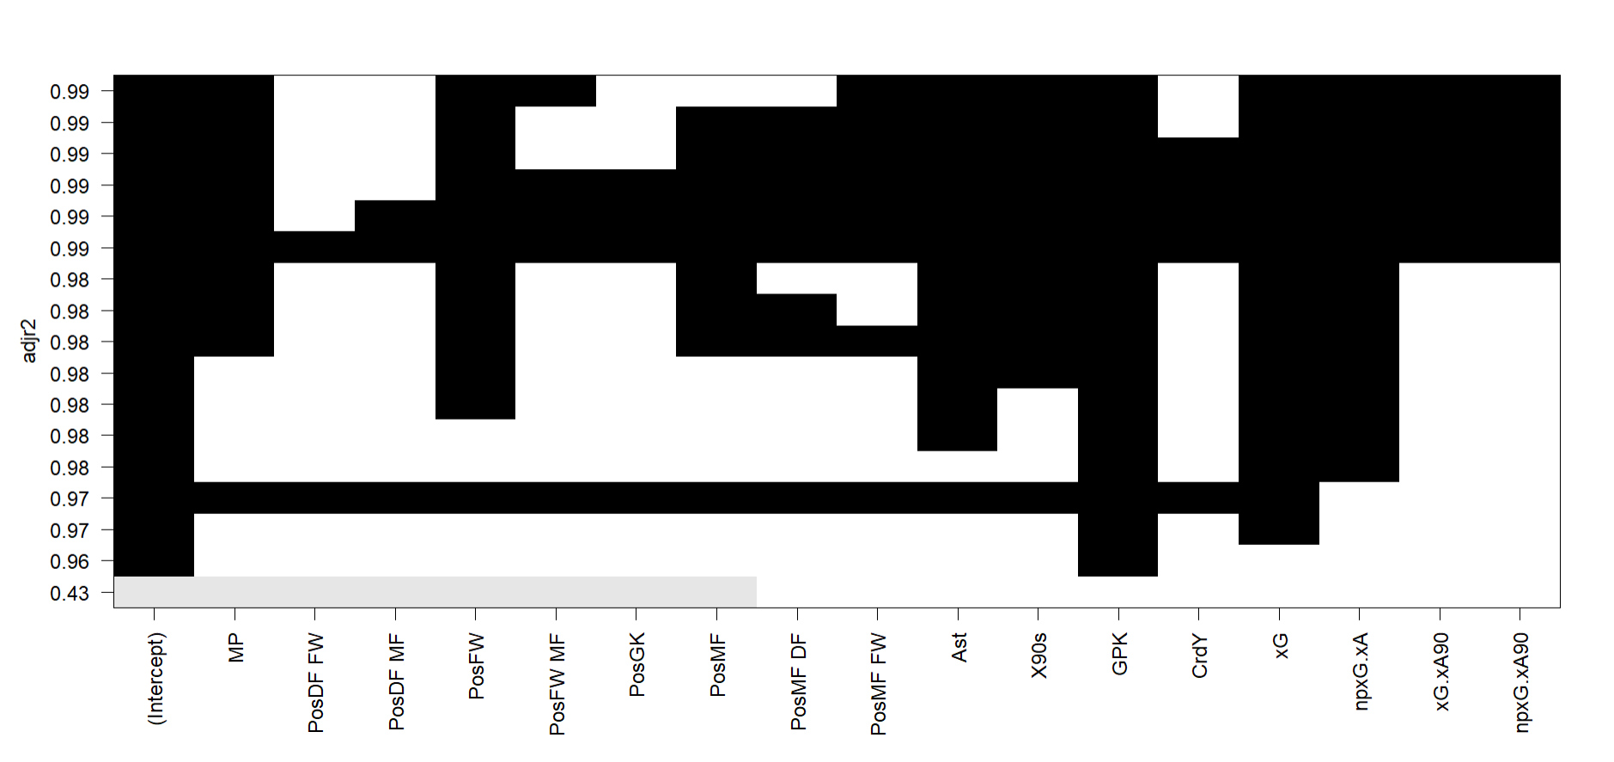
The figure is obtained after running the Linear Model with the ‘Best Subset method’ which shows the Adjusted R-square and the variables that are required to make our model precise. According to the final 0.99, Forwards have scored the most goals, followed by Midfielders and the Goals minus Penalty Kicks, Expected Goals, Assists and Expected, Non-Expected Goals per 90 minutes are the prominent ones to give us our Y and the Players importance.

Slide 12
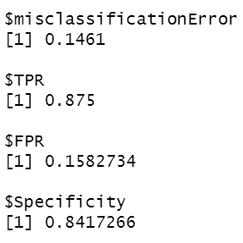
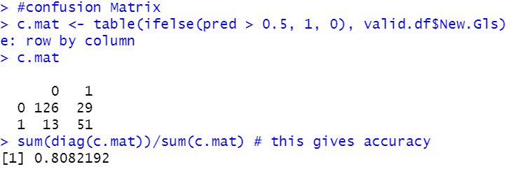
2.)The Logistic Regression is run to see which variables are important and this matrix gives us the highest Accuracy value of 81 percent which is not seen in any of the above confusion matrices. The increase of True Positives along with the False Positives with minimum number of the Negatives is the proof for such accuracy.

Slide 13
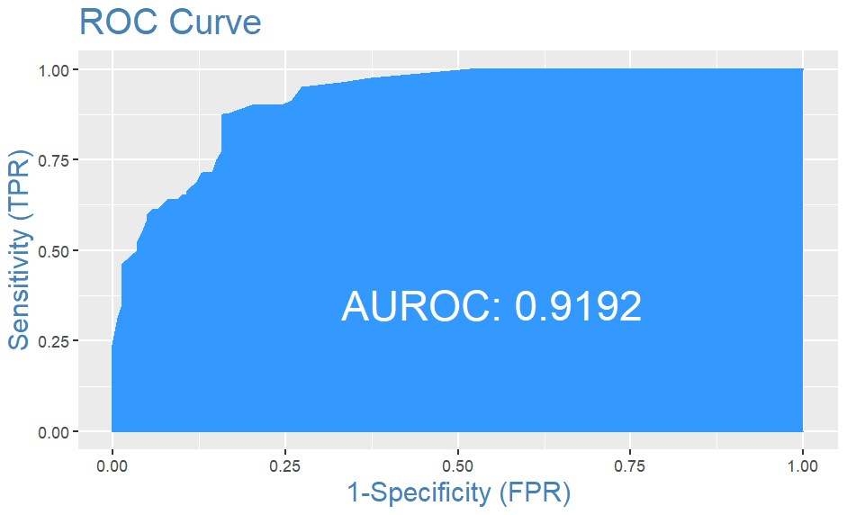
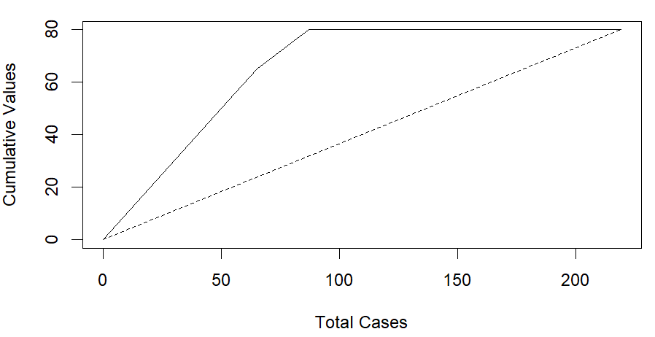
The Actual and Predicted values are just the same when it comes to zero or one and the Validation data almost matches the predicted values with less standard variation, no deviation residuals and good amount of Specificity by Sensitivity. The ROC curve has an Area of 92 percent, the highest seen so far, and is the best model with very less misclassification and good amount of True Positive values. The values keep going till 0.5 and have gradual breaks until the 0.75 mark. After a sharp rise again till 0.85, there is only one break until it reaches 1.00 and flows continuously after the 0.25 x values.

Slide 14
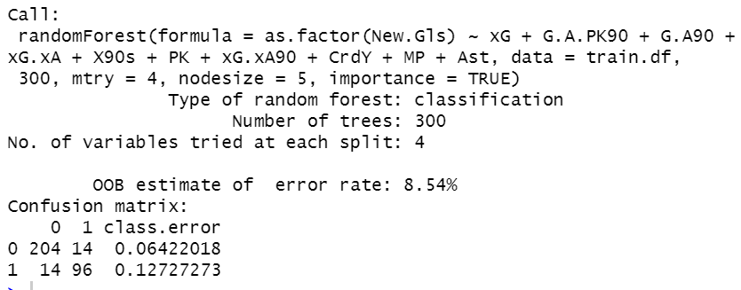
3.) Pruned Tree and Random Forest: The random forest has been run for the previous 10 variables to compare and check if the output is better than the Logistic regression. There are 204 False positives with 96 True positives, the same as Pruned tree. The error rate is only 8.6 percent meaning our model is very good comparatively and is not under the tendency of overfitting or underfitting with less negatives.

Slide 15
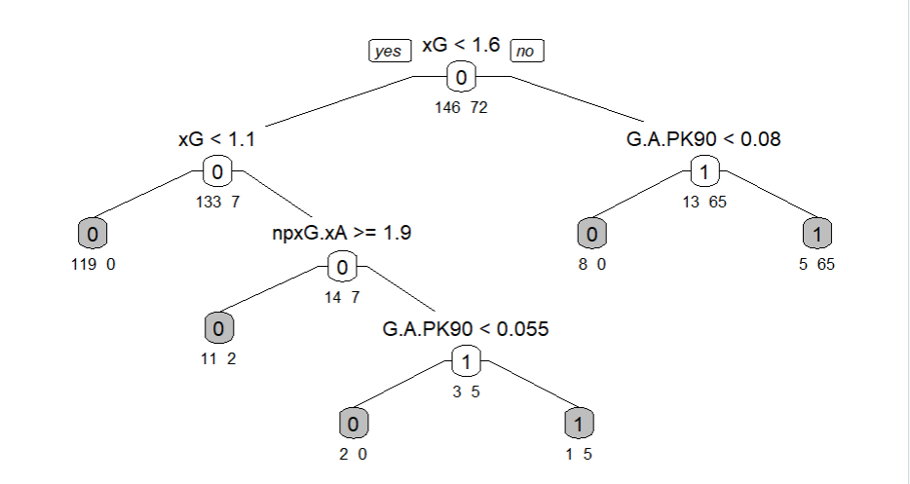
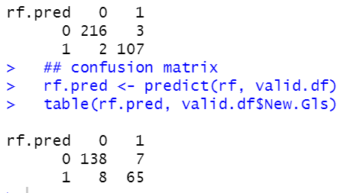
The Expected Goals ratio after pruning in the validation data has increased from 1.4 to 1.6 respectively. There is an increase in True positives from 51 to 65 compared to Model 1 and False positives have increased from 126 to 138. The negatives are in single digits indicating that the Accuracy of the model has increased to be more than 85 percent in the pruned tree.

Slide 16
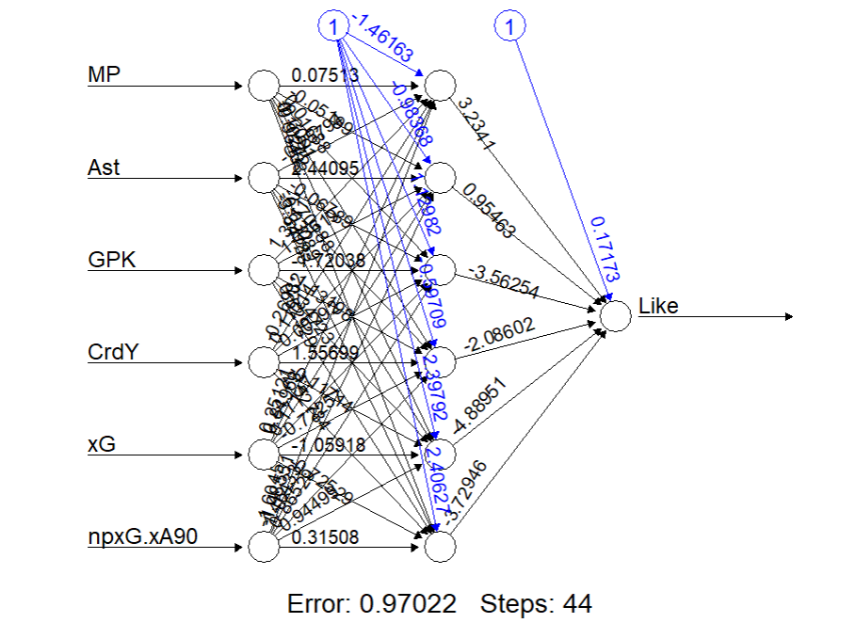
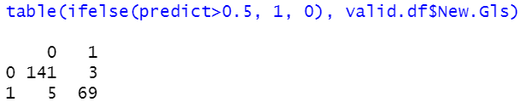
4.) Neural Network classification: This NN-plot has an error of less than 1 percent and a greater number of steps (44) than any other models making it the best model of all. According to the values below, there are only single digit negatives, and the True positives are 69, much greater when compared to Model-1 or 2 and, with the False positives topping at 141. Our Model has significantly improved, and the error has also been reduced as seen below.

Slide 17
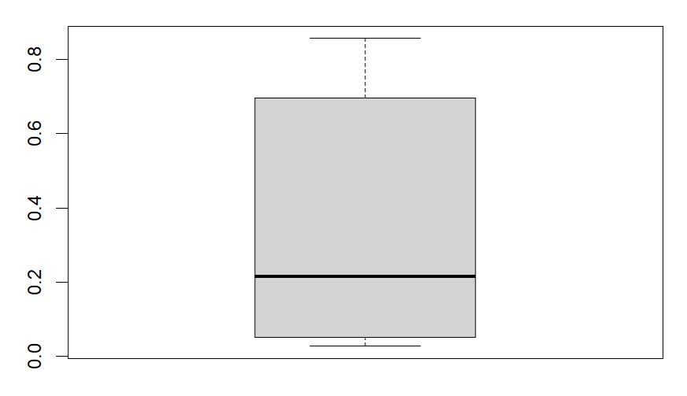
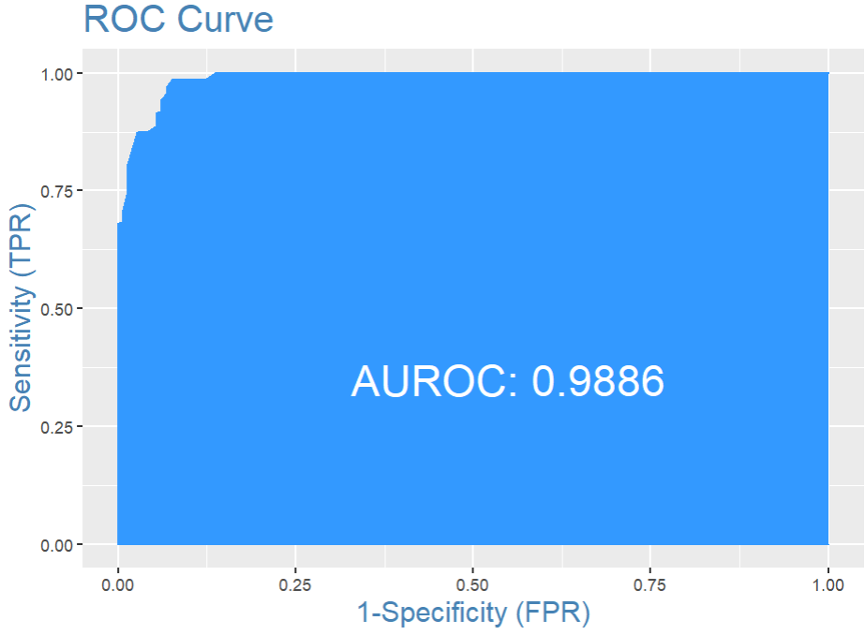
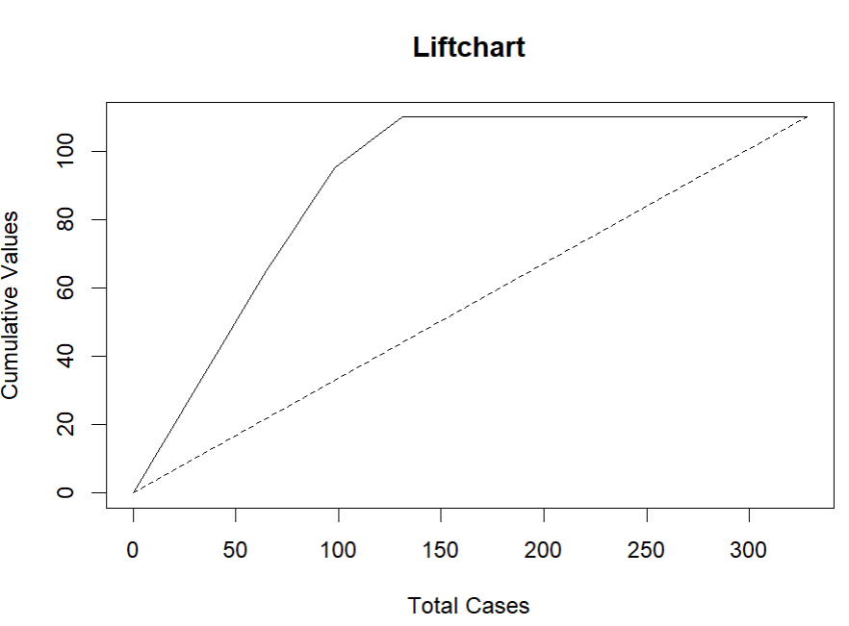
The ROC Curve below has 99 percent area covered under it indicating it has been better than the other Models data and can be called as the Best. The Boxplot below shows us that the median of the values ranges at 0.2 while the minimum and maximum stand at 0 and 0.9 respectively showing just how good our model is.

Slide 18
Thus, all these Models and Methods have shown that the Goals variable is directly depended on the Expected Goals variable, Goals minus Penalty Kicks, Non-Expected Goals, assists per 90 mins of the game, Assists, and Matches played. The rest of the variables did not seem that important and including or removing variables does not make any sense as the most important variables masked the others during classification. The categorical variables are out of scope as models cannot run them with the numbers, and we cannot generate a Model with the Player names or their Positions and classify. Out of the Best Models that were obtained in the Linear Regression, Logistic Regression model, the highest number of True positives were only 51 when compared to 72, the highest in the Tree model. The error misclassification was 14 percent and Optimal cut-off was 26 percent making it the least considerable. Though the True positives and Sensitivity of the model is more than 85 percent, it still has only 91 percent area in the ROC and is not up to the mark when compared to the Trees or the Neural Network models.
Summary and Conclusion:

Slide 19
Link: https://www.kaggle.com/datasets/omkargowda/football-players-stats-premier-league-20212022
Data Source:

Slide 20



